Slide 1
COMP6200 Data Science Project Group AC
Team Members :
Arth Mukeshbhai Patel(46117253)
Vaibhav Aggarwal(45516065)
Gayathri Renukanath Mahendraker(45780307)
Rakshit Puniani(46167587)

Slide 2
Our Data
The source of the data is Kaggle
Googleplaystore.csv (This file contains details of the applications on Google Play. It includes 13 features, such as rating, categories etc)
googleplaystore_user_reviews.csv (This file contains the reviews for each app)
The Data was obtained via Kaggle however, Data cleaning is required as there are a lot of unwanted data. Also we go for text cleaning and then select to perform the semantic analysis on comments. One of the CSV files also contain sentiment analysis but we perform it again for better accuracy.

Slide 3
Our Problem statement
In project our aim to analyses application’s comments, review and ratings. We are interested in whether there is a relationship between the comments and the reviews of the applications with the ratings. We may also explore the relationships according to features like categories and type (free/Paid applications). Also, according to the rating and reviews, we predict the usage of the application by the users. We may also explore the relationships of the downloads and other features.
Movies with the ratings and check the Reviews show any relationship with the ratings or not.

Slide 4
Analysis steps
For perform this analysis we first explore the Dataset
Data cleaning
Data visualization
Model selection

Slide 5
Preprocessing the dataset 1
File: googleplaystore.csv
In the dataset there are13 features, such as rating, categories etc. However, all features contain the string data except Ratings.
Convert the necessary columns of the dataset like price, category, reviews count, downloads to float.
Remove the unwanted and null values from the dataset.

Slide 6
Preprocessing the dataset 2
File: googleplaystore_user_reviews.csv
In the dataset there are columns of the comments semantic type, subjectivity and polarity and appname.
Using the NLTK movies review dataset we train the model and then test our model and update column with new semantic type (positive/negative reviews). And using Textblob library we update subjectivity and polarity of the comments.
Remove the unwanted and null values from the dataset.

Slide 7
Data Insights we found

Slide 8
From the plot we can see that most Apps are of Family category while the Beauty category had the least number of Apps.

Slide 9
From our datasets we can gather that 93.1% of the total Apps are free while the rest 6.89% of Apps are the paid ones in the Google Playstore.

Slide 10
The graph shows that the reviews of the people for every age group that has watched the movie. There are reviews from most of the people but the teens and mature +17 have lesser reviews given.

Slide 11
This graph shows sentiment Analysis of the comments where we can see that the comments have negative biasing.

Slide 12
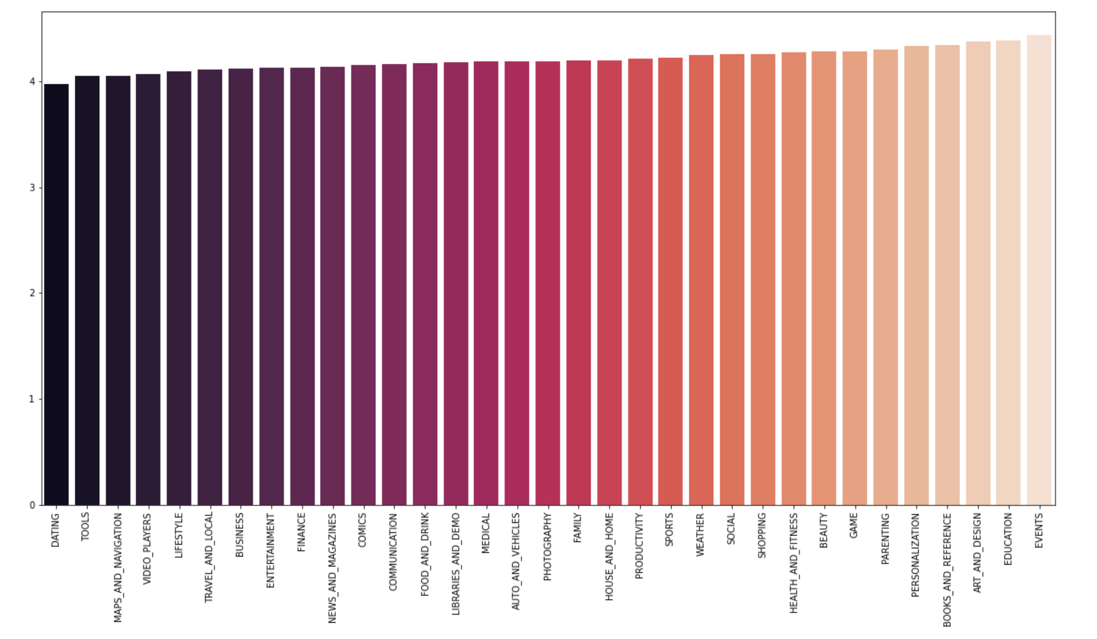
The graph represent the average rating of apps by category.
From the graph we can see that all the apps have average ratings above 4 except the Dating category, Highest average rating belongs to the Events category

Slide 13
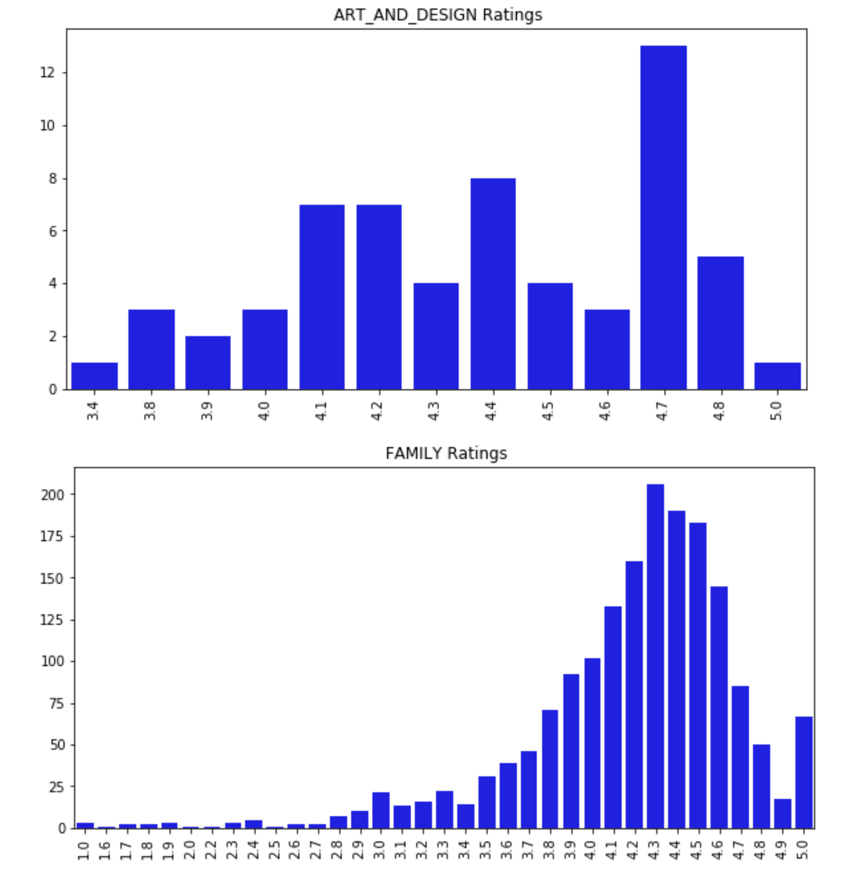
The graph represent the average rating of each category.
Here, from the ART_AND_DESIGN category graph we can see mostly people gave 4.7 ratings.
For the FAMILY category most of the ratings were between 4.3 to 4.5.

Slide 14
How we did our project
File : Googleplaystore_user_reviews.csv
We preprocessed the data and update sentiment, Sentimnet_polarity and sentimnet_subjectivity columns
Wrote a method to generate words as features
We Fetch the training dataset from the NLTK movies data.
After we used Naive Bayes Classifier and Logistic Regression to our trained dataset. And check the accuracy score which is nearly same.

Slide 15
How we did our project
File : Googleplaystore.csv
We preprocessed the data and convert datasets columns to float which are mandatory to perform analysis.
For converting columns like content and category we use labelencoder().
Last, we perform the different models such as linear regression, random forest regressor and decision tree regressor. And compare the score and f1 values.

Slide 16
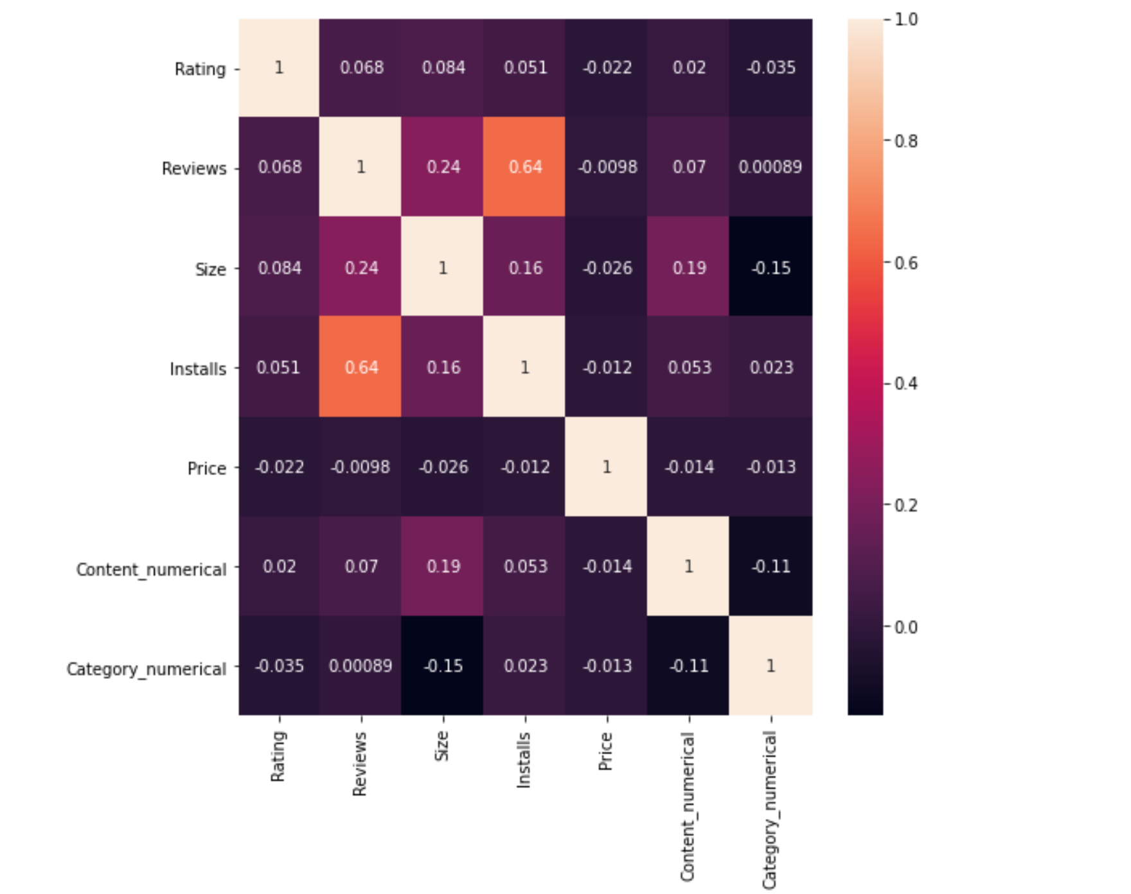
From the correlation heatmap plot we can see that most of the features do not show strong relation between each others.
However the reviews show the strong relation with installs and follow by the Size.

Slide 17
Conclusions
From the comments of the google play apps we can see that the comments shows mostly negative biased. However, we can see that mostly rating around the more than 4 out of 5. So we can say that there is no relationship with the comments and ratings.
After performing the models such as linear , random forest and decision tree regression we can notice that the score is not good enough and the mse value is high.
As per our aim of the project we can conclude that there is no relationship between the ratings, count of reviews and comments. Moreover, we also notice that reviews effect on the installation of the apps.

Slide 18
Thank you

